Slide 1

A101 Science
Problem 04: AM I Stable?
6th Presentation
Copyright © 2010

Slide 2
Protons, neutrons and electrons
Atoms being the basic building blocks of matter around us, are composed of protons, neutrons and electrons.
The protons are positively charged particles and electrons are negatively charged particles, while neutrons do not carry any charge.
Atoms are electrically neutral, as the number of protons and electrons must be the same.

Slide 3
Atomic structure
In the centre of an atom is the nucleus where the protons and neutrons can be found. The electrons move at high speeds in a region around the nucleus.
Electrons are able to remain in the region around the nucleus due to electrostatic attraction between the positively-charged nucleus and the negatively-charged electrons.
Negatively charged electrons are around the nucleus
Nucleus
Proton (positively charged)
Neutron (neutral)

Slide 4
Electronic arrangement
Each part of the region (electron shell) is associated with fixed energy level and can only hold a fixed number of electrons.
The occupied shell furthest away from the nucleus is known as the valence shell with electrons residing in it defined as valence electrons.
Energy
3rd Shell (Maximum 18 e)
2nd Shell
(Maximum 8 e)
1st Shell
(Maximum 2 e)

Slide 5
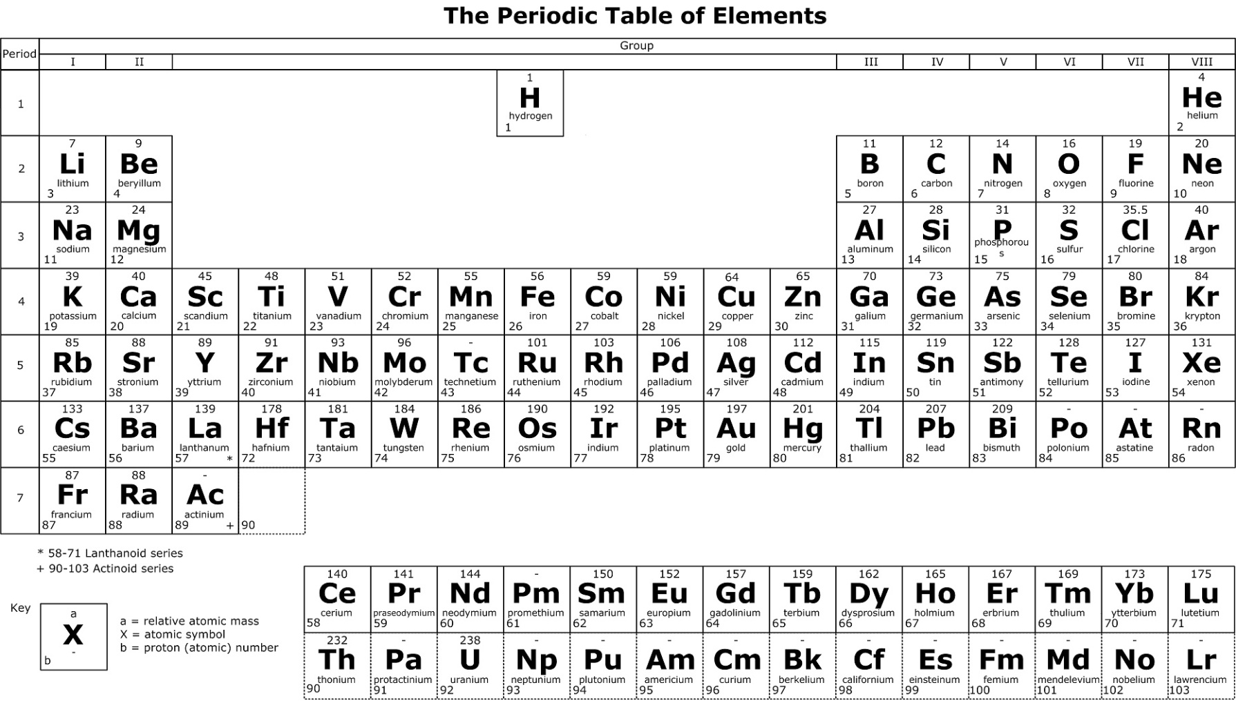
Periodic Table
The Periodic Table is a conventional way to organize the various atoms according to various trends.
The Group number tells us the number of valence electrons
The Period number tells us the number of occupied electron shells
The relative atomic mass provides an indication on the number of protons and neutrons
The proton number tells us the number of protons (or electrons)

Slide 6
Atomic size
The atomic size of an atom takes into account the number of shells occupied by the electrons.
Nuclear charge refers to the total charge of the protons and it measures the attractive forces between the nucleus and the electrons.
This implies that the valence electrons would be drawn closer to the nucleus if an atom has more protons (smaller atomic size).

Slide 7
Atomic size
For the atoms with electrons occupying more than one electron shell, the inner electrons tend to repel the valence electrons.
Hence, the valence electrons experience a weaker attraction if an atom has more inner electrons.
Nuclear charge and the number of inner electrons have opposing effects on the atomic size.
Relating this back to the Periodic Table, it can be deduced that the atomic size increases down the Group but decreases across the Period.

Slide 8
Stability of an atom
Most atoms rarely exist on their own except for the Noble gases.
The valence shells of the atoms of Noble gases contain either 2 electrons (for atoms with one electron shell i.e. Helium) or 8 electrons (e.g. Neon and Argon).
This is the basis of their stability and ability to exist as single atoms.
In general, an atom found in Group I to VII (first twenty elements only) will try to attain stability by combining with other atoms so that it can have 2 valence electrons (i.e. H, Li, Be) or 8 valence electrons (e.g. Al, Cl, O, C) after the combination.

Slide 9
Ways in which atoms can combine together
Na and Cl atoms have one and seven valence electrons respectively.
To achieve stability, it is easier for Na atom to combine with Cl atom by transferring its only valence electron to Cl atom.
As a result, the Cl atom’s valence shell contains 8 electrons, while in the Na atoms, the 2nd shell containing 8 electrons becomes the valence shell.
The valence shell of Cl does not change.

Slide 10
Ways in which atoms can combine together
This transfer of electron results in the formation of charged particles known as ions.
The Na atom loses one electron and acquires a positive charge to become a positive ion, Na⁺, while Cl atom gains one electron will now acquire a negative charge to become a negative ion, Cl⁻.
An ionic compound is thus formed.
+
Na
Na
Cl
Cl⁻

Slide 11
Ways in which atoms can combine together
A similar interaction is observed between Mg and O atoms, which combine to give MgO.
Hence, it can be concluded that to achieve stability, atoms of elements such as Na and Mg have the tendency to lose their valence electrons to form positive ions since they typically have fewer valence electrons (these atoms are typically atoms of metallic elements).
On the other hand, atoms of elements such as Cl and O have the tendency to gain extra electrons to form negative ions due to the presence of more valence electrons (these atoms are typically atoms of non-metallic elements).

Slide 12
Ways in which atoms can combine together
In Cl₂, it is unlikely for electrons to be transferred as each Cl atom prefers to gain an extra electron.
Atoms can also combine through the sharing of their valence electrons to form molecules.
Cl
Cl

Slide 13
Ways in which atoms can combine together
Combination of atoms results in the formation of chemical bonds.
Atoms involved in the bonding are able to stay close to each other due to the attraction between the positive nuclei of one atom and the negative valence electrons of the other that are used for bonding.
The transfer of electrons results in ionic bonds while the sharing of electrons results in covalent bonds.

Slide 14
Ways in which atoms can combine together
Extra points to take note of:
  Atoms can gain or lose more than one valence electron e.g. O²⁻ and Mg²⁺.
  An atom can combine with more than one atom at the same time e.g. MgCl₂ and NH₃.
  Two atoms may form multiple bonds with each other e.g. in O₂.
O
O

Slide 15
Learning points
An atom is composed of protons and neutrons found inside the nucleus with electrons revolving around this nucleus.
The size of an atom can be influenced by the nuclear charge and the number of inner electrons present.
Most atoms attain stability by forming chemical bonds which takes place either through the transfer of electrons or sharing of electrons.

Slide 16
Discussion
Some information is provided for two unknown compounds AB₂ & XY₂:
AB₂ is formed by ionic bonding
XY₂ is formed by covalent bonding
What can you deduce from the information about their constituent elements A, B, X, Y above?

